Slide 1
Explore
Ecosystems
Learn more about ecosystems!
Take the Ecosystem Quiz!
Standards

Slide 2
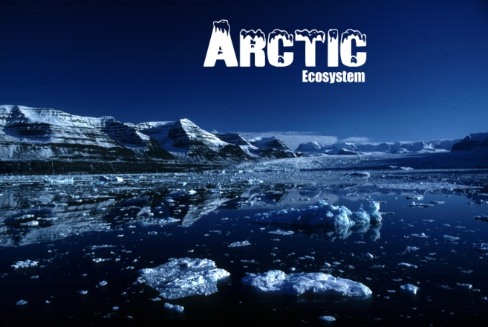
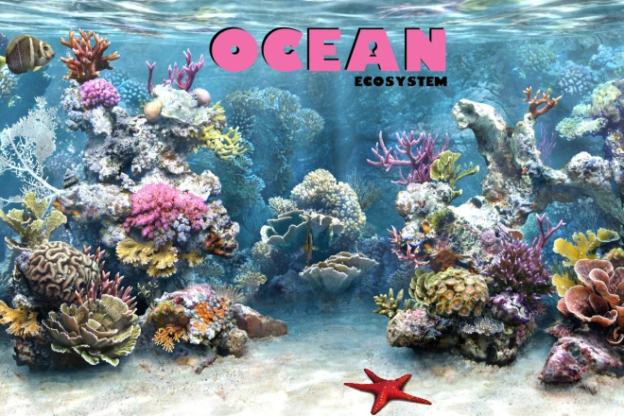
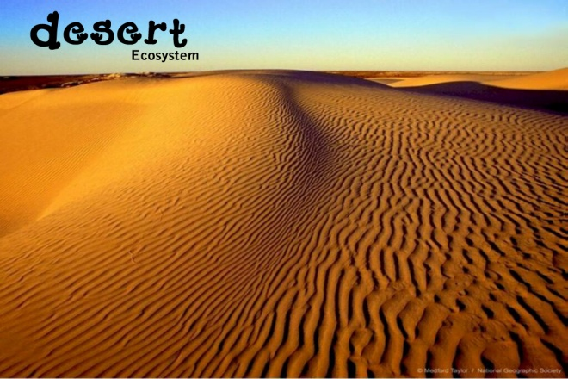
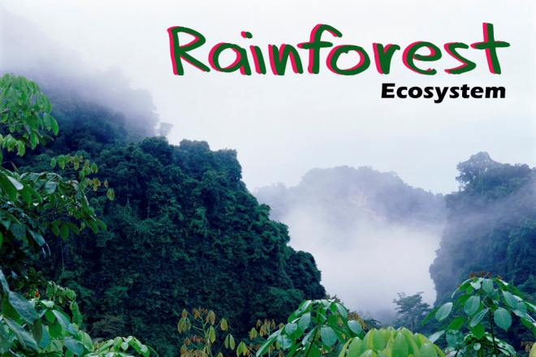
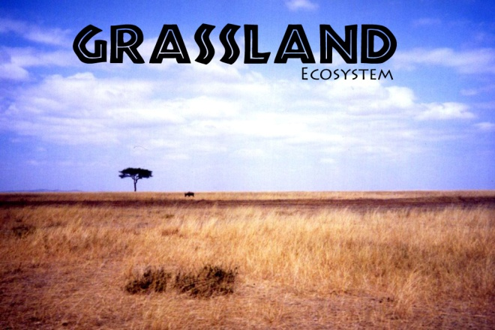
Ecosystems
Ready for the Ecosystem Quiz?

Slide 3
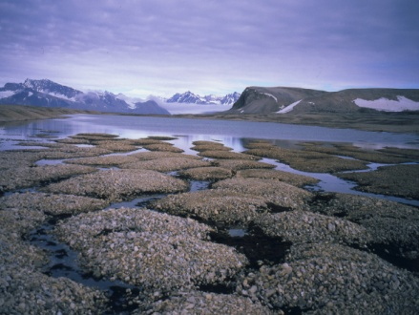
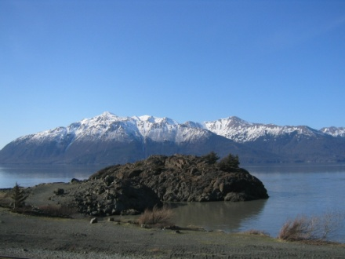
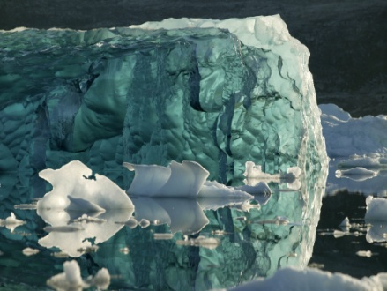
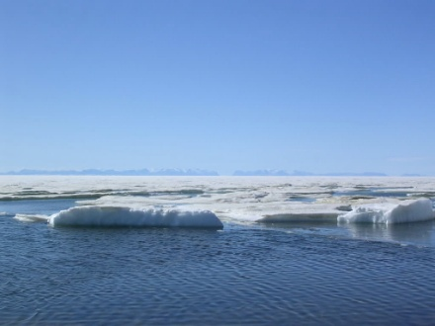
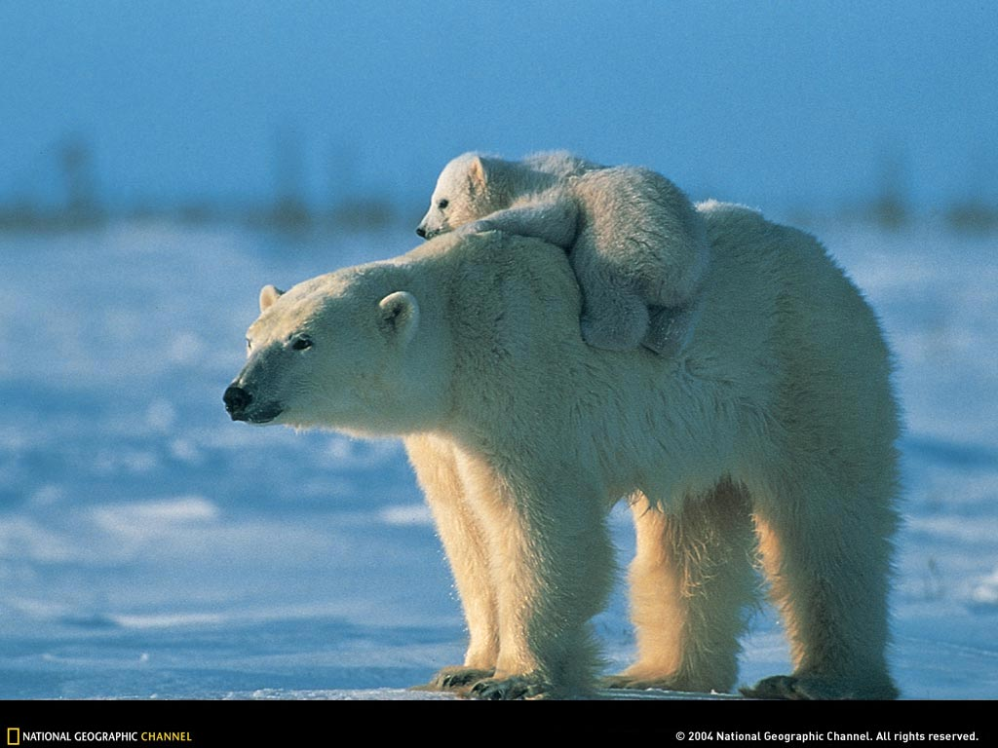
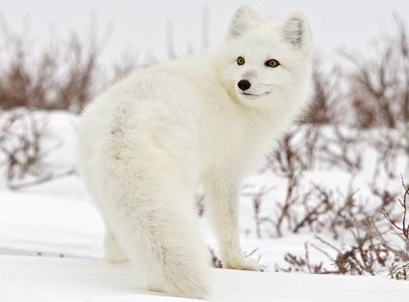
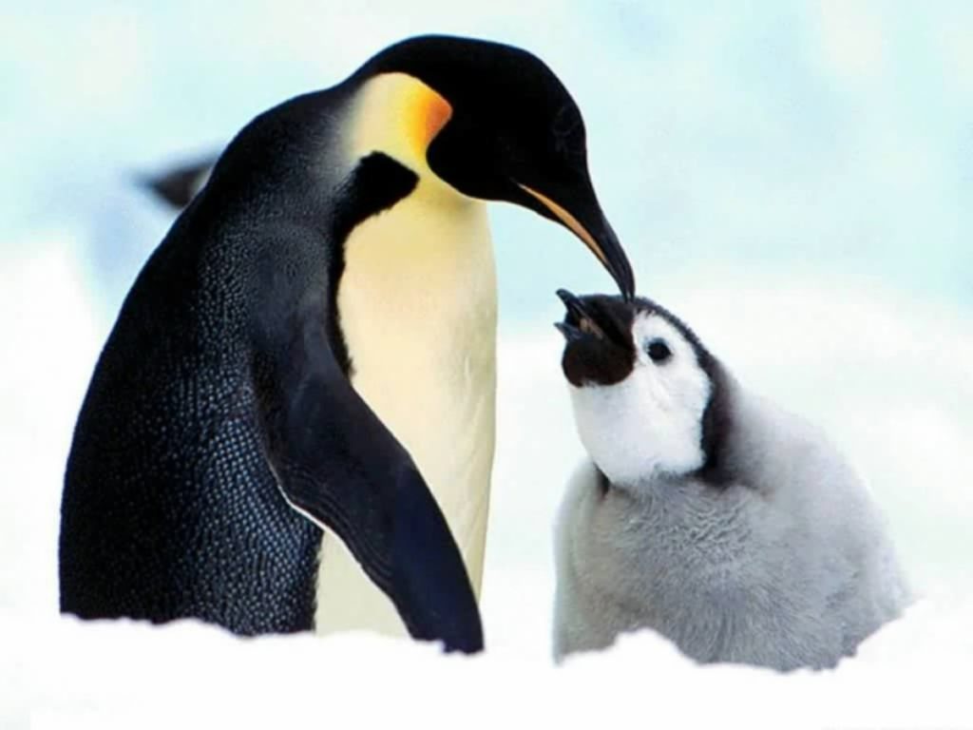
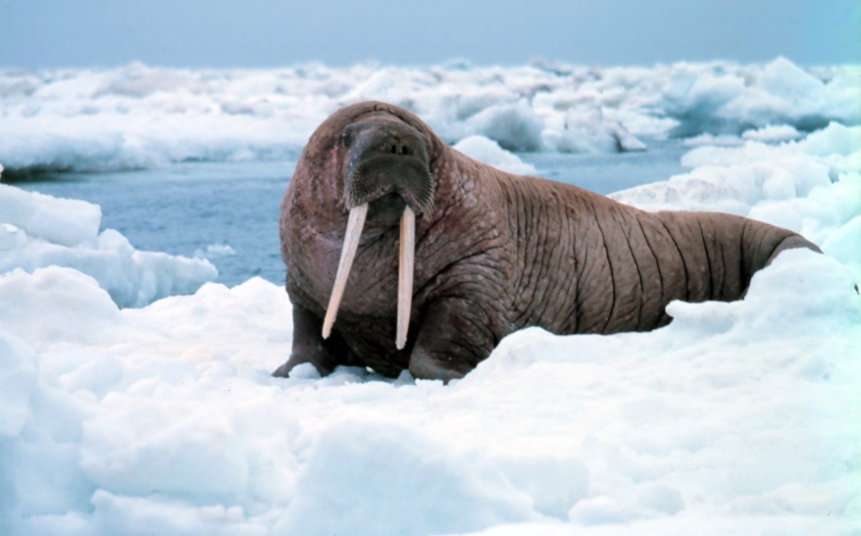
Arctic Ecosystem
Location: Arctic Circle or North Pole.
Climate: Very cold. Snow and ice all year.
Landscape:
Animals:
Back to ecosystems

Slide 4
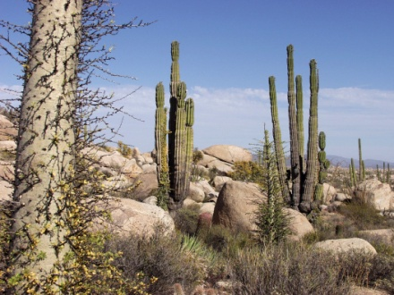
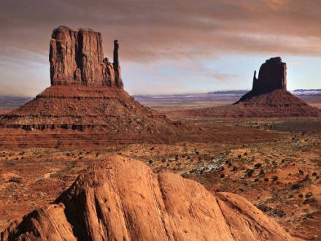
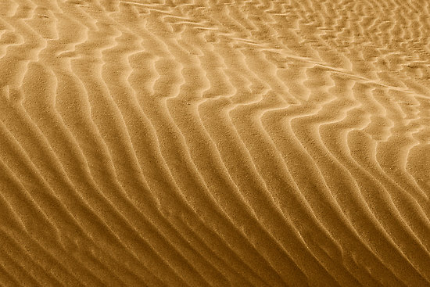
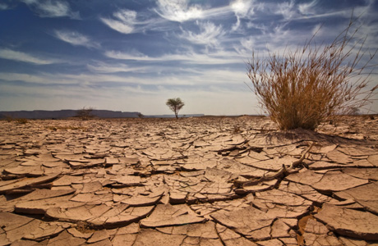
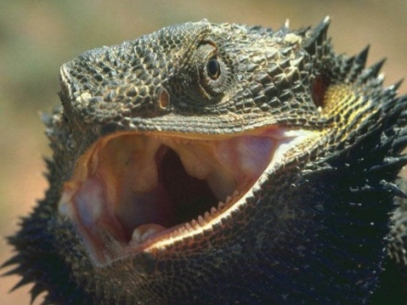
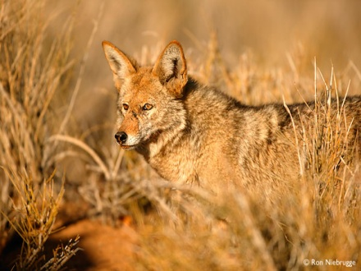
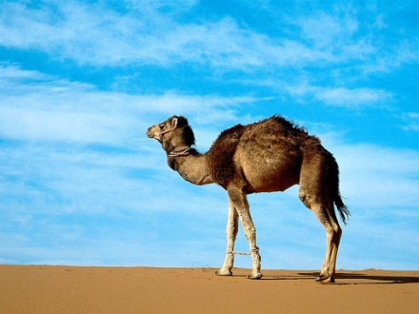
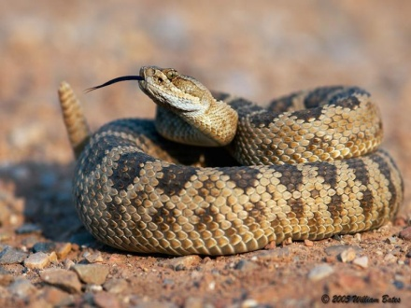
Desert Ecosystem
Location: All over the world: USA, Africa, Australia and Asia.
Climate: Hot during the day, cold at night, very dry.
Landscape:
Animals:
Back to ecosystems

Slide 5
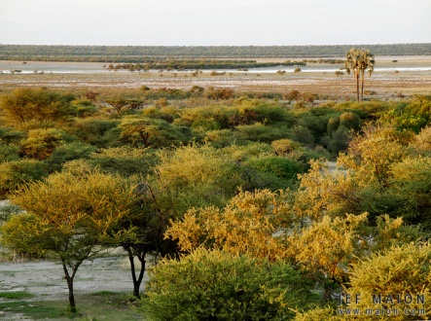
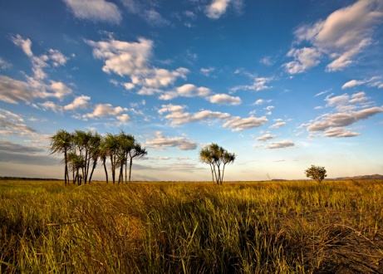
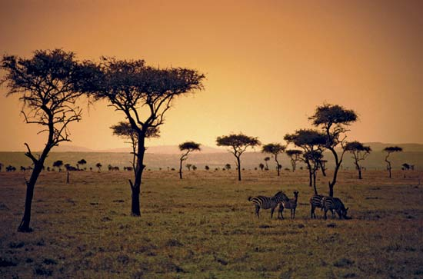
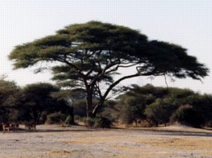
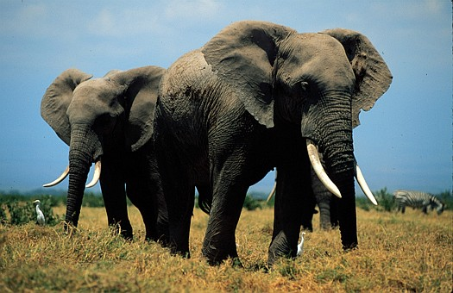
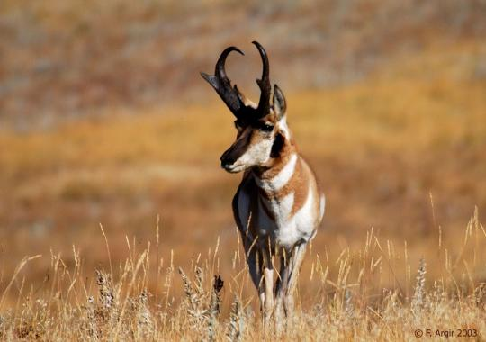
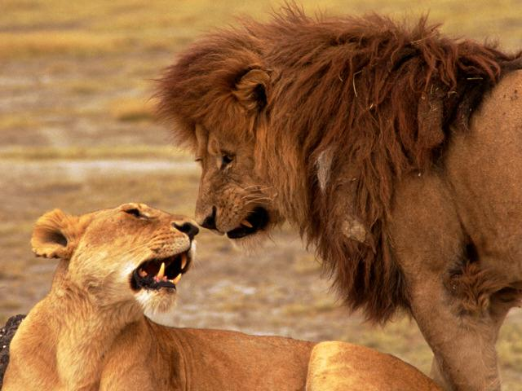
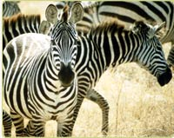
Grassland Savanna Ecosystem
Location: Africa (similar savannas can be found in Australia).
Climate: Hot, mostly dry with short seasons of rain.
Landscape:
Animals:
Back to ecosystems

Slide 6
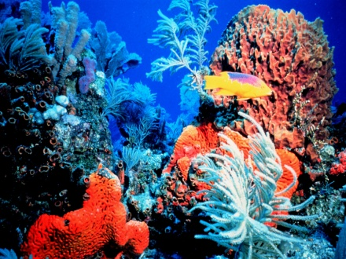
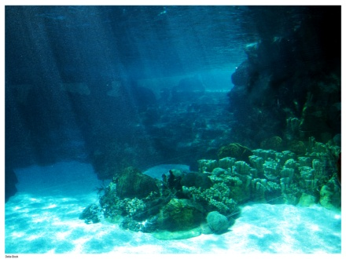
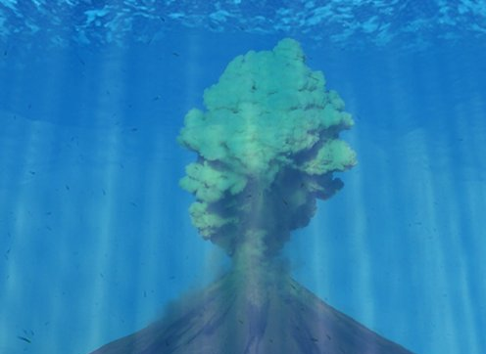
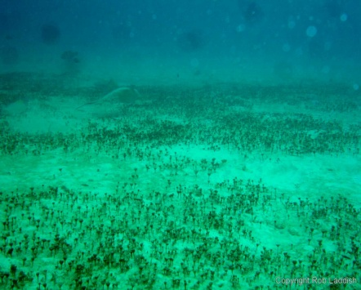
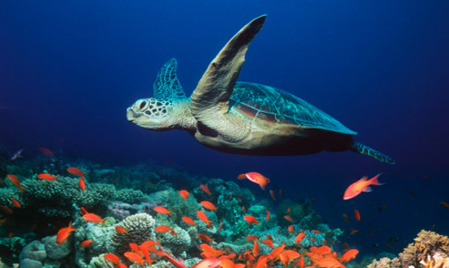
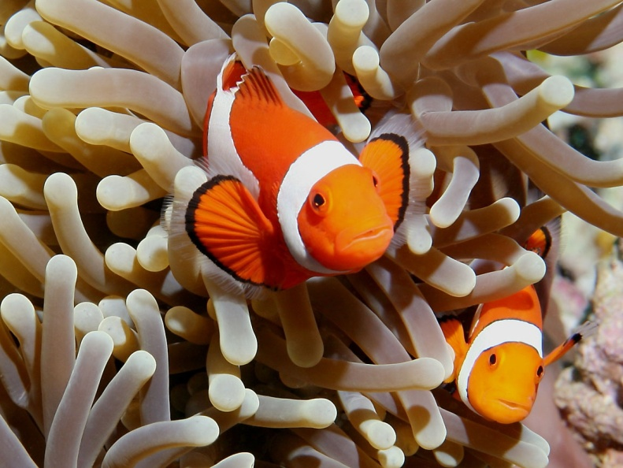
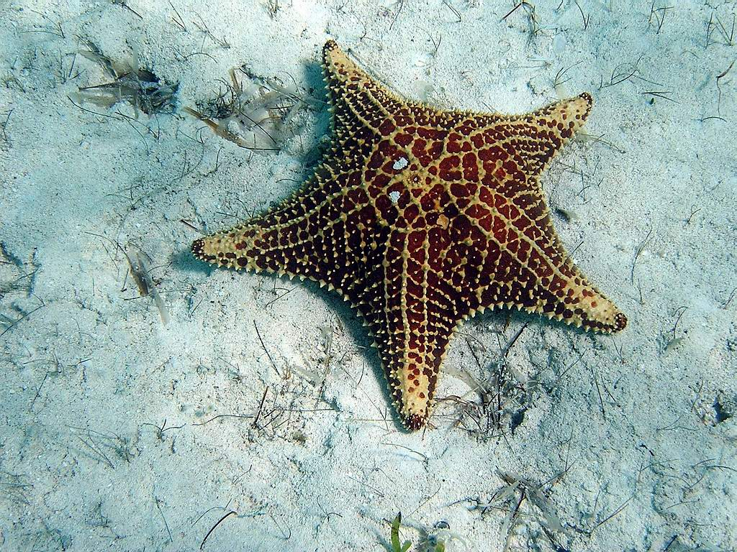
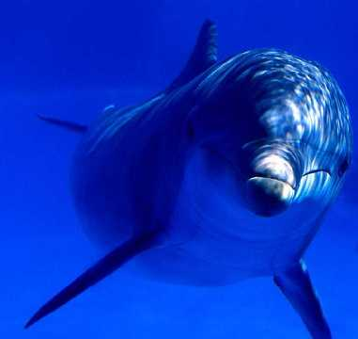
Ocean Ecosystem
Location: All of the world. Four major oceans: Arctic, Indian, Pacific and Atlantic
Climate: Depending on location, ranges from freezing cold to warm temperatures
Landscape:
Animals:
Back to ecosystems

Slide 7
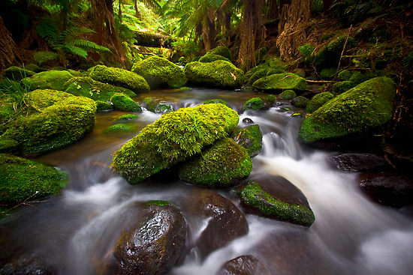
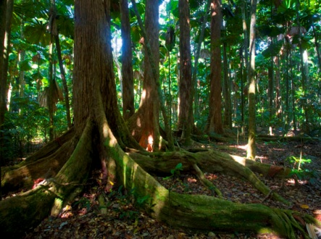
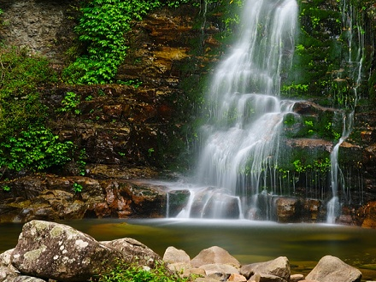
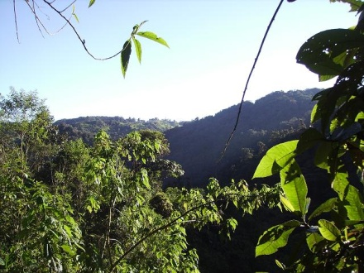
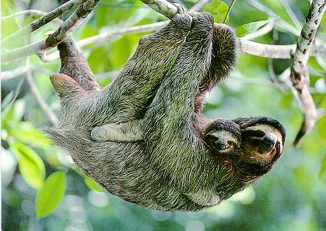
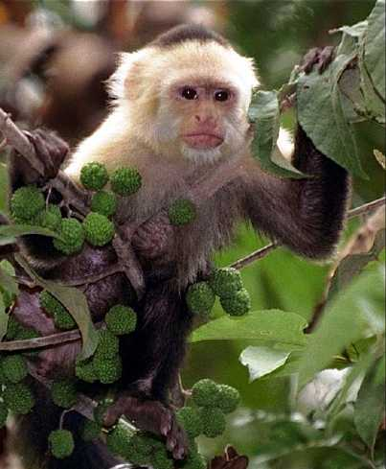
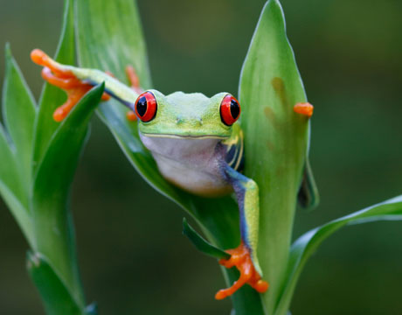
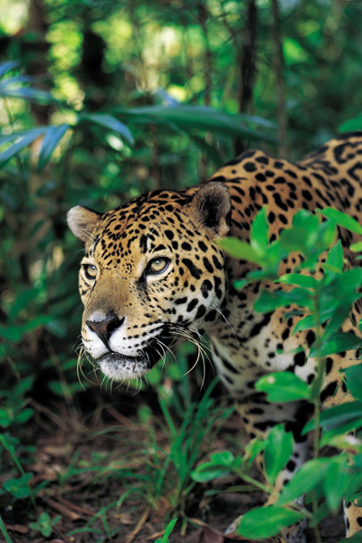
Rainforest Ecosystem
Location: South America, Africa and Asia
Climate: Very hot and humid. Rains an average of 80 inches each year!
Landscape:
Animals:
Back to ecosystems

Slide 8
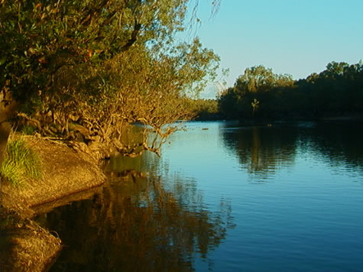
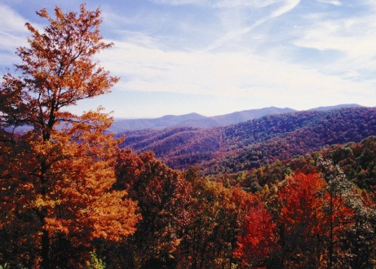
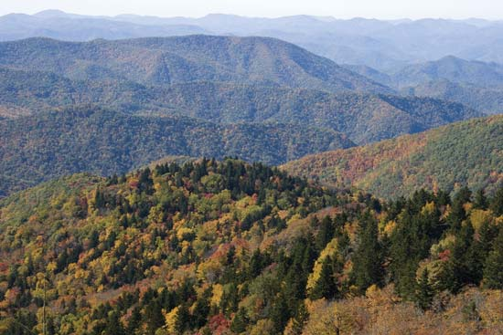
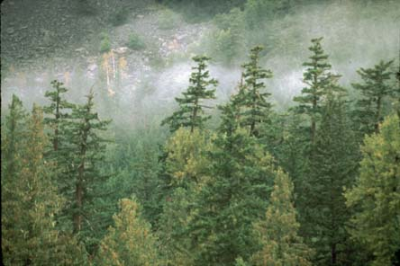
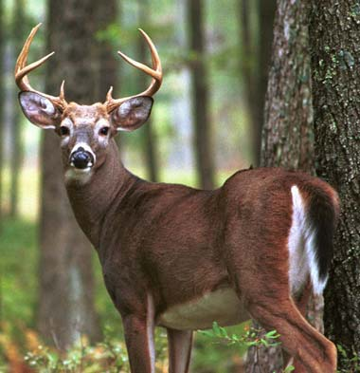
Temperate Ecosystem
Location: North America, Europe, Asia and Australia
Climate: Warm/hot summers and cool/cold winters. Average rain and snow.
Landscape:
Animals:
Back to ecosystems

Slide 9
Ecosystem Quiz
Which ecosystem has warm/hot summers and cool/cold winters?
A. Temperate ecosystem
B. Rainforest ecosystem
C. Grassland savanna ecosystem

Slide 10
Try Again!
Go Back

Slide 11
Right!
Next Question!

Slide 12
Ecosystem Quiz
Rainforest ecosystems are most threatened by?
A. Poaching
B. Deforestation
C. Littering

Slide 13
Try Again!
Go Back

Slide 14
Right!
Next Question!

Slide 15
Ecosystem Quiz
How is the ocean ecosystem being affected by humans?
A. Dolphins are becoming endangered due to poaching
B. Ocean is being polluted by people dumping chemicals and oil spills
C. It isn’t being affected

Slide 16
Try Again!
Go Back

Slide 17
Right!
Next Question!

Slide 18
Ecosystem Quiz
What types of plants would you see in a desert ecosystem?
A. Tall trees and lots of small plants
B. Cactus plants and tumbleweed
C. Small bushes and evergreens

Slide 19
Try Again!
Go Back

Slide 20
Right!
Next Question!

Slide 21
Ecosystem Quiz
True or False: You could find a skunk in a temperate ecosystem.
True
False

Slide 22
Try Again!
Go Back

Slide 23
Right!
Next Question!

Slide 24
Ecosystem Quiz
Which ecosystem would you find a lion in?
A. Temperate ecosystem
B. Desert ecosystem
C. Grassland savanna ecosystem

Slide 25
Try Again!
Go Back

Slide 26
Right!
Next Question!

Slide 27
Ecosystem Quiz
What type of weather would you find in a grassland savanna ecosystem?
A. Very rainy and humid
B. Mainly dry with short seasons of rain
C. Hot summers and cold winters

Slide 28
Try Again!
Go Back

Slide 29
Right!
Next Question!

Slide 30
Ecosystem Quiz
Which ecosystem is will suffer the most if temperatures get warmer?
A. Rainforest ecosystem
B. Arctic ecosystem
C. Desert ecosystem

Slide 31
Try Again!
Go Back

Slide 32
Right!
Next Question!

Slide 33
Ecosystem Quiz
Which ecosystem has a very dry climate that is hot during the day and cool at night?
A. Ocean ecosystem
B. Arctic ecosystem
C. Desert ecosystem

Slide 34
Try Again!
Go Back

Slide 35
Right!
Next Question!

Slide 36
Ecosystem Quiz
True or False: Ocean ecosystems can range from cold to warm temperatures.
True
False

Slide 37
Try Again!
Go Back

Slide 38
Right!
End of quiz! Learn more about ecosystems!

Slide 39
Third Grade Standards
Social Studies: Standard 3: Geography
Students will explain that simple grid systems (latitude and longitude) are used to locate places on maps and globes, and will begin to understand the Earth/sun relationship, identify the distinctive physical and cultural features of their community, and explain the geographic relationships within their own community with the state and other states within the region.
3.3.10 Environment and Society: Use a variety of information resources to identify regional environmental issues and examine the ways that people have tried to solve these problems.
3.3.11 Environment and Society: Identify and describe the relationship between human systems and physical systems and the impact they have on each other.
Science Standard 4: The Living Environment
Students learn about an increasing variety of organisms. They use appropriate tools and identify similarities and differences among them. Students explore how organisms satisfy their needs in typical environments.
3.4.1 Demonstrate that a great variety of living things can be sorted into groups in many ways using various features, such as how they look, where they live, and how they act, to decide which things belong to which group
3.4.2 Explain that features used for grouping depend on the purpose of the grouping.
Home

